Slide 1
Chapter 21
Basic Numerical Procedures

Slide 2
Approaches to Derivatives Valuation
Trees
Monte Carlo simulation
Finite difference methods

Slide 3
Binomial Trees
Binomial trees are frequently used to approximate the movements in the price of a stock or other asset
In each small interval of time the stock price is assumed to move up by a proportional amount u or to move down by a proportional amount d

Slide 4
Movements in Time Δt
(Figure 21.1)
p
Su
S
1 – p
Sd

Slide 5
Tree Parameters for asset paying a dividend yield of q
Parameters p, u, and d are chosen so that the tree gives correct values for the mean & variance of the stock price changes in a risk-neutral world
Mean: e^{(r−q)Δt} = pu + (1– p )d
Variance: σ²Δt = pu² + (1– p )d ² – e^{2(r−q)Δt}
A further condition often imposed is u = 1/ d

Slide 6
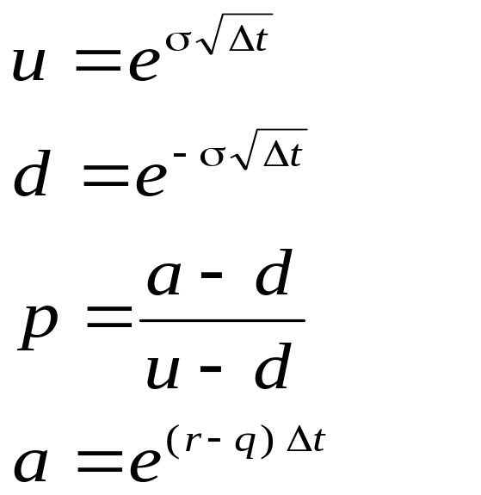
Tree Parameters for asset paying a dividend yield of q
(continued, equations 21.4 to 21.7)
When Δt is small a solution to the equations is

Slide 7
The Complete Tree
(Figure 21.2)
S₀u⁴
S₀u³
S₀u²
S₀u²
S₀u
S₀u
S₀
S₀
S₀
S₀d
S₀d
S₀d²
S₀d²
S₀d³
S₀d⁴

Slide 8
Backwards Induction
We know the value of the option at the final nodes
We work back through the tree using risk-neutral valuation to calculate the value of the option at each node, testing for early exercise when appropriate

Slide 9
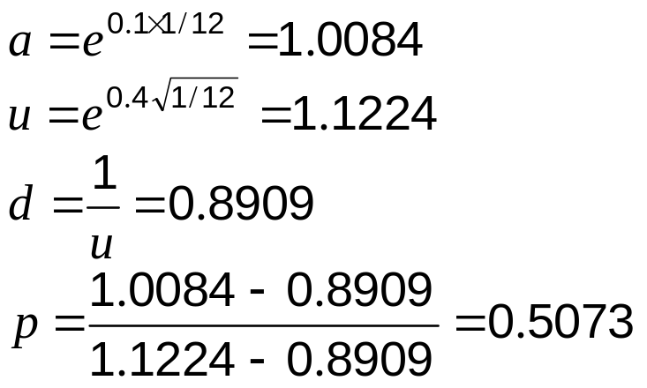
Example: Put Option
(Example 21.1)
  S₀ = 50; K = 50; r =10%; σ = 40%;
T = 5 months = 0.4167; Δt = 1 month = 0.0833
In this case

Slide 10
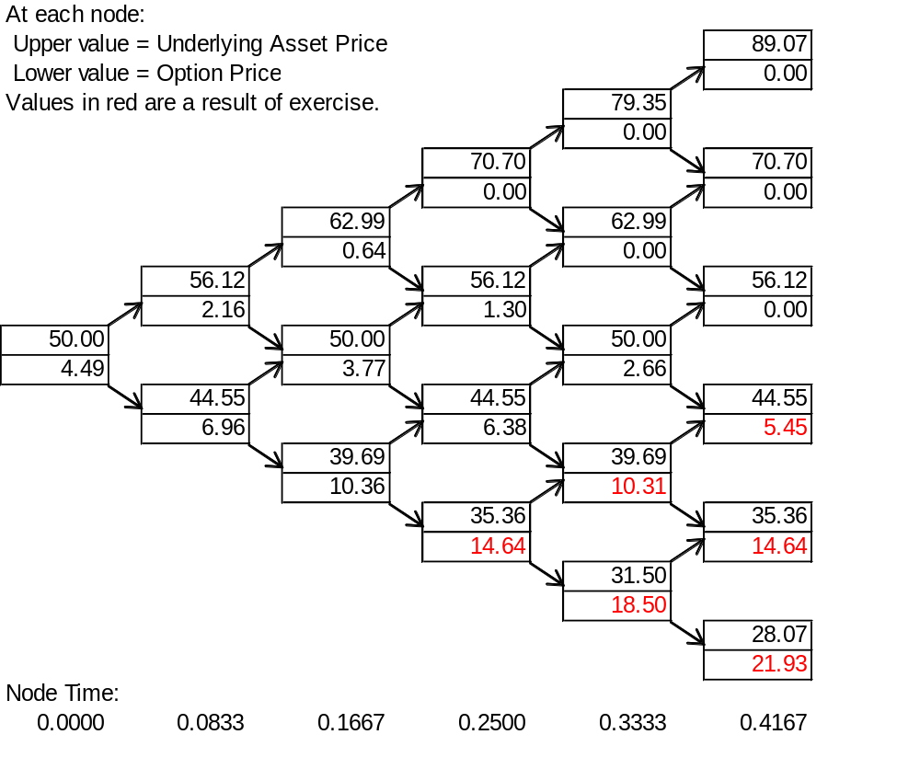
Example (continued; Figure 21.3)

Slide 11
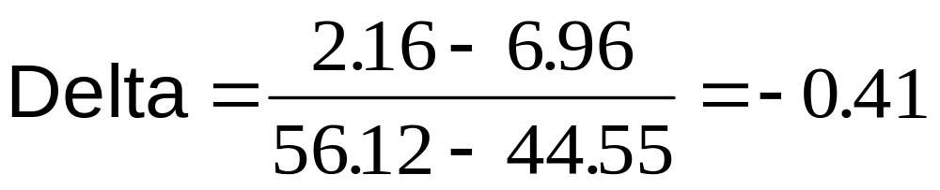
Calculation of Delta
Delta is calculated from the nodes at time Δt

Slide 12
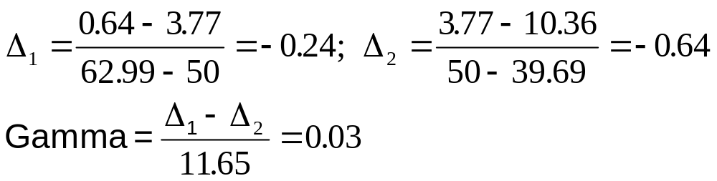
Calculation of Gamma
Gamma is calculated from the nodes at time 2Δt
=0.5(62.99+50)−0.5(50+39.69)

Slide 13
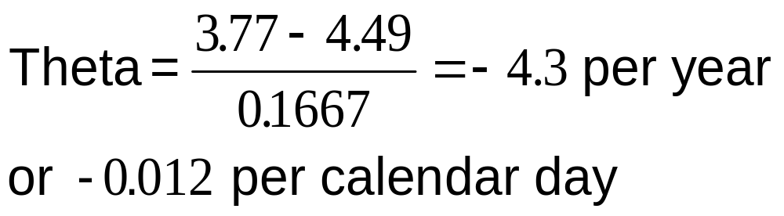
Calculation of Theta
Theta is calculated from the central nodes at times 0 and 2Δt

Slide 14
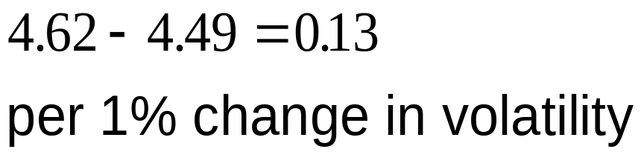
Calculation of Vega
We can proceed as follows
Construct a new tree with a volatility of 41% instead of 40%.
Value of option is 4.62
Vega is

Slide 15
Trees for Options on Indices, Currencies and Futures Contracts
As with Black-Scholes-Merton:
  For options on stock indices, q equals the dividend yield on the index
  For options on a foreign currency, q equals the foreign risk-free rate
  For options on futures contracts q = r

Slide 16
Binomial Tree for Stock Paying Known Dividends
Procedure:
  Construct a tree for the stock price less the present value of the dividends
  Create a new tree by adding the present value of the dividends at each node
This ensures that the tree recombines and makes assumptions similar to those when the Black-Scholes-Merton model is used for European options

Slide 17
Control Variate Technique
Value American option, f_{A}
Value European option using same tree, f_{E}
Value European option using Black-Scholes –Merton, f_{BS}
Option price =f_{A}+(f_{BS} – f_{E})

Slide 18
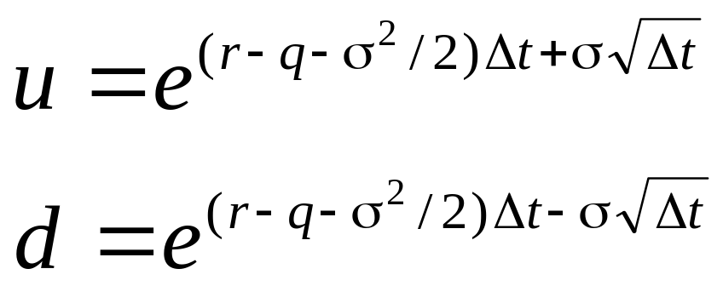
Alternative Binomial Tree
Instead of setting u = 1/d we can set each of the 2 probabilities to 0.5 and

Slide 19
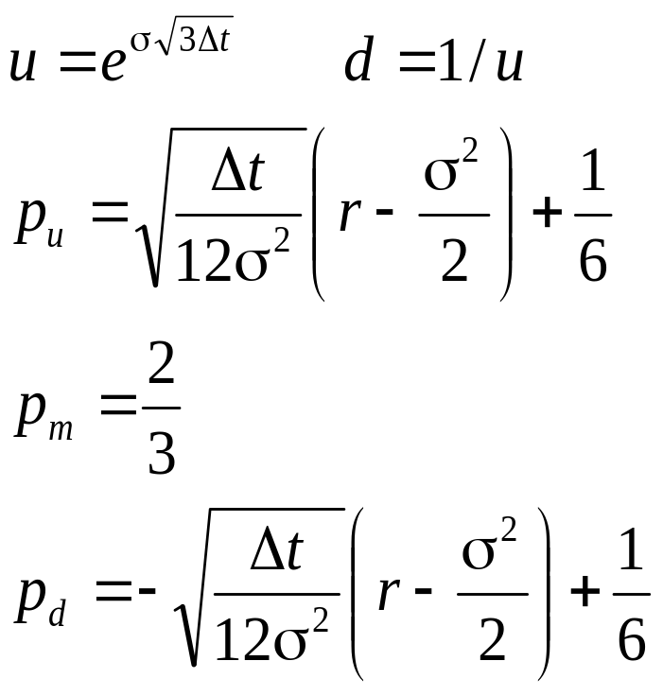
Trinomial Tree
Su
p_{u}
p_{m}
S
S
p_{d}
Sd

Slide 20
Time Dependent Parameters in a Binomial Tree
Making r or q a function of time does not affect the geometry of the tree. The probabilities on the tree become functions of time.
We can make σ a function of time by making the lengths of the time steps inversely proportional to the variance rate.

Slide 21

Monte Carlo Simulation and π (Figure 21.13)
How could you calculate π by randomly sampling points in the square?

Slide 22
Monte Carlo Simulation and Options
When used to value European stock options, Monte Carlo simulation involves the following steps:
1. Simulate 1 path for the stock price in a risk neutral world
2. Calculate the payoff from the stock option
3. Repeat steps 1 and 2 many times to get many sample payoffs
4. Calculate mean payoff
5. Discount mean payoff at risk free rate to get an estimate of the value of the option

Slide 23
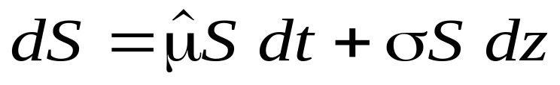
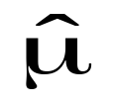
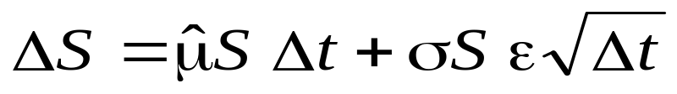
Sampling Stock Price Movements
In a risk neutral world the process for a stock price is
where is the risk-neutral return
We can simulate a path by choosing time steps of length Δt and using the discrete version of this
where ε is a random sample from φ(0,1)

Slide 24
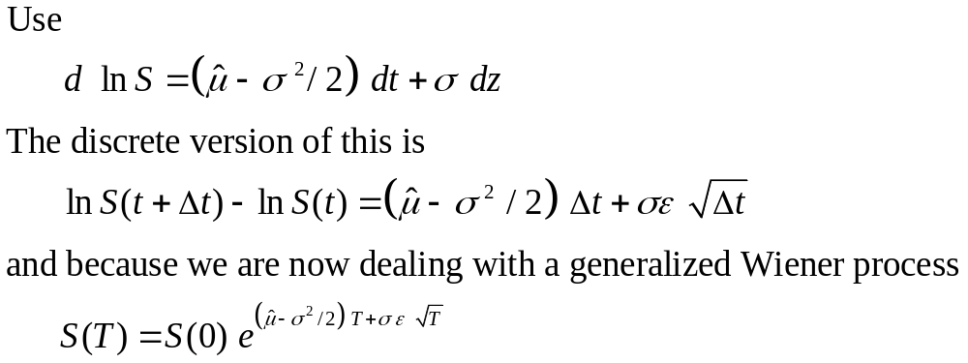
A More Accurate Approach
(Equation 21.17)

Slide 25
Extensions
When a derivative depends on several underlying variables we can simulate paths for each of them in a risk-neutral world to calculate the values for the derivative

Slide 26
Sampling from Normal Distribution
In Excel =NORMSINV(RAND()) gives a random sample from φ(0,1)

Slide 27
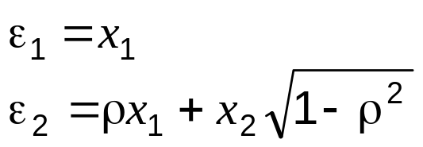
To Obtain 2 Correlated Normal Samples
Obtain independent normal samples x₁ and x₂ and set
Use a procedure known as Cholesky’s decomposition when samples are required from more than two normal variables

Slide 28
Standard Errors in Monte Carlo Simulation
The standard error of the estimate of the option price is the standard deviation of the discounted payoffs given by the simulation trials divided by the square root of the number of observations.

Slide 29
Application of Monte Carlo Simulation
Monte Carlo simulation can deal with path dependent options, options dependent on several underlying state variables, and options with complex payoffs
It cannot easily deal with American-style options

Slide 30
Determining Greek Letters
For Δ:
1. Make a small change to asset price
2. Carry out the simulation again using the same random number streams
3. Estimate Δ as the change in the option price divided by the change in the asset price
Proceed in a similar manner for other Greek letters

Slide 31
Variance Reduction Techniques
Antithetic variable technique
Control variate technique
Importance sampling
Stratified sampling
Moment matching
Using quasi-random sequences

Slide 32
Sampling Through the Tree
Instead of sampling from the stochastic process we can sample paths randomly through a binomial or trinomial tree to value a derivative
At each node that is reached we sample a random number between 0 and 1. If it is between 0 and p, we take the up branch; if it is between p and 1, we take the down branch

Slide 33
Finite Difference Methods
Finite difference methods aim to represent the differential equation in the form of a difference equation
We form a grid by considering equally spaced time values and stock price values
Define ƒ_{i,j} as the value of ƒ at time iΔt when the stock price is jΔS

Slide 34
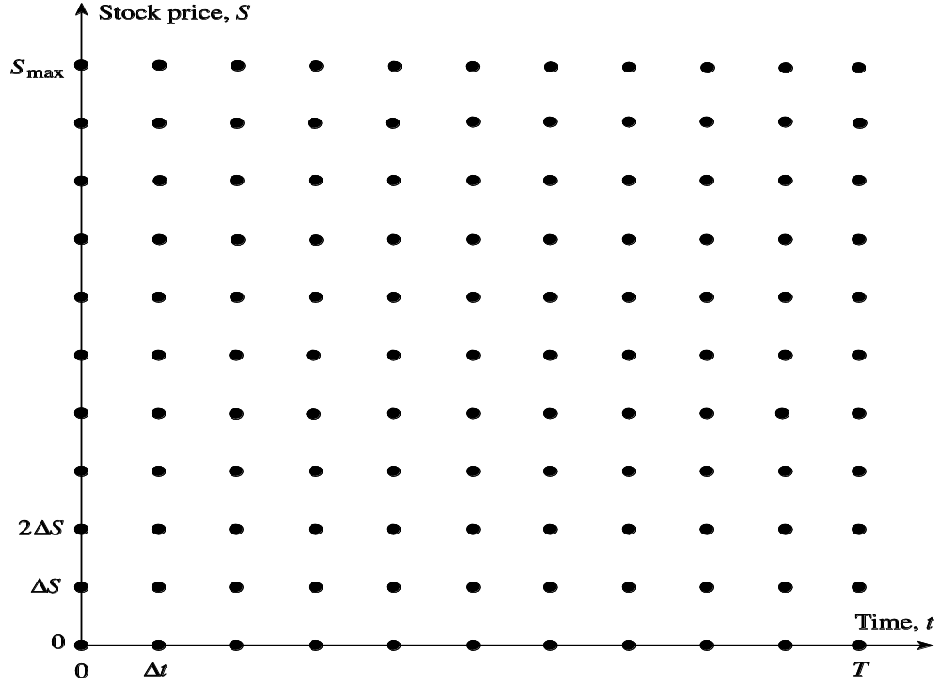
The Grid (Figure 21.5)

Slide 35
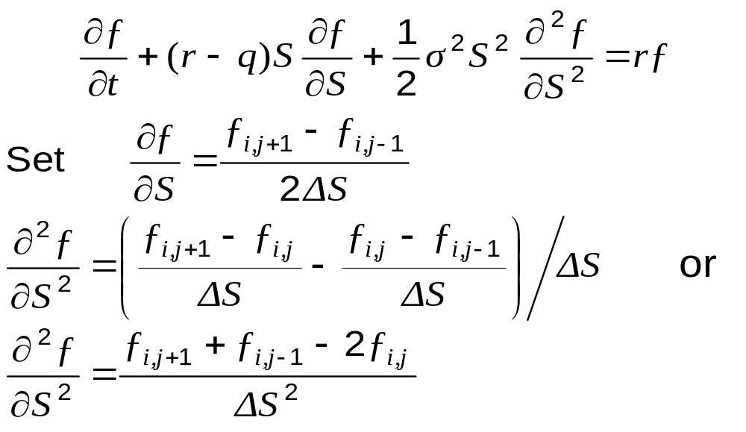
Finite Difference Methods
(continued, equations 21.24 and 21.26)

Slide 36
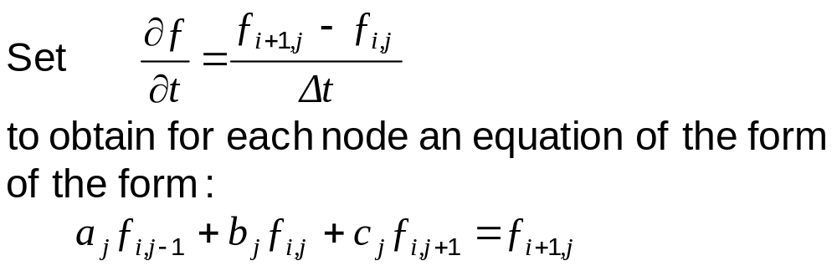
Implicit Finite Difference Method

Slide 37
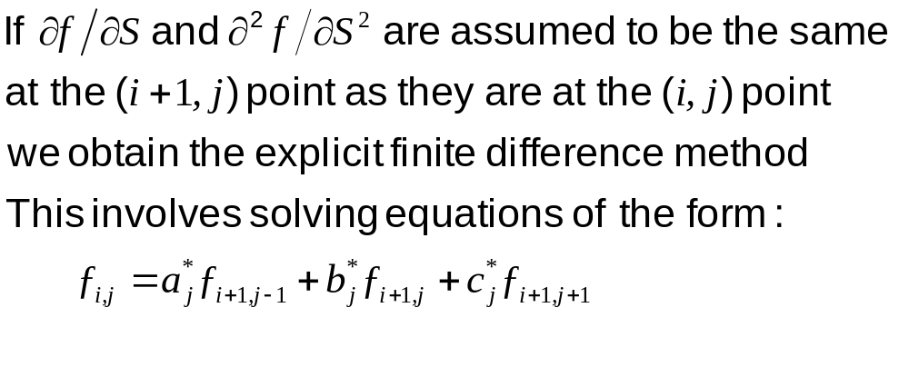
Explicit Finite Difference Method

Slide 38
Implicit vs Explicit Finite Difference Method
The explicit finite difference method is equivalent to the trinomial tree approach
The implicit finite difference method is equivalent to a multinomial tree approach

Slide 39
Implicit vs Explicit
Finite Difference Methods (Figure 21.16)
ƒ_{i , j +1}
ƒ_{i +1, j +1}
ƒ_{i , j}
ƒ_{i +1, j}
ƒ_{i , j}
ƒ_{i +1, j}
ƒ_{i , j –1}
ƒ_{i +1, j –1}
Implicit Method
Explicit Method

Slide 40
Other Points on Finite Difference Methods
It is better to have ln S rather than S as the underlying variable
Improvements over the basic implicit and explicit methods:
  Hopscotch method
  Crank-Nicolson method

